Slide 1
Symmetry and Group Theory

Slide 2
What is a group?
A group is a set $G$ equipped with an operation $∘$ such that four conditions are satisfied:
1. The set is closed under this operation, namely $a∘b∈G$ given $a, b∈G$
2. This operation is associative, meaning that for $a,b,c∈G$, we have $a∘\left(b∘c\right)=\left(a∘b\right)∘c$
3. There is an element $e$ in $G$, called the identity, that satisfies $e∘g=g$ for any $g∈G$
4. For every $g∈G$, there is a corresponding inverse $g^{−1}$ such that $g^{−1}∘g=e$
This operation doesn’t have to be commutative, so it is possible $a∘b≠b∘a$, but if it does for every pair $a,b∈G$, we say this group is Abelian.
From now on, for convenience, we use drop the operation symbol and write $a∘b$ as $ab,$ unless a certain symbol for this operation is specified.

Slide 3
Example 1
We choose the set to be $G=ℤ=\{0,±1,±2,…\}$, and equip it with the “addition” operation $+$. Then it will be a group.
Check condition 1 (closure): the sum of two integers is still an integer.
Check condition 2 (associativity): $\left(a+b\right)+c=a+(b+c)$
Check condition 3 (identity): 0 is our identity
Check condition 4 (inverse): $−m$ is the inverse of $m$
Bonus condition (Abelian): $a+b=b+a$

Slide 4
Example 2
We choose the set $G=S_{n}$ to be permutation operations on the ordered set of numbers $\left\{1, 2, …,n\right\}$, and equip it with the operation of composition. (So our group is itself a set of operations, and the group operation we equip is a composition of operations. Don’t get entangled.)
Take $n=3$ as an example, $G=S_{3}=\left\{e,\left(12\right), \left(23\right),\left(13\right),\left(123\right),\left(321\right)\right\}$, each element in the group will change the order of the string $123$ (it is a concatenation of three numbers)
L$ike \left(23\right)$ will change 123 to 132, while $\left(123\right)$ will change 123 to 231. And if we compose them, (123)(23) will change 123 to 213, since (23) changes 123 to 132 and (123) further changes it into 213. We can see (123)(23) is equivalent to (12), as required by the closure condition.

Slide 5
Example 2, continued (and introduce the order of a group)
Check condition 1 (closure): Of course, no matter how we change the order, it is always a string with numbers “1, 2, 3”
Check condition 2 (associativity): Somehow also obvious, but could be cumbersome to state in a rigorous math manner, so I will just cheat here by skipping it.
Check condition 3 (identity): $e$ is the identity, which doesn’t change anything
Check condition 4 (inverse): Just change it backwards
Unfortunately, this group is not Abelian.
We can also see there are a total of $n!$ elements in $G=S_{n}.$ This number will be called “order” if there are finite elements. Usually it is denoted by $\left|G\right|,$ so $\left|S_{n}\right|=n!$

Slide 6
Example 3
We choose $G=SO(n)$ to be the set of rotation operations in the $n$-dimensional space and equip it with a group operation of composition.
Each element can be represented by a pair $(n,θ)$ to indicate the axis and the angle of the rotation.
It is hard to visualize the effect of composing several rotations, especially in higher dimensions, so the best way to prove the validity of the four conditions is to resort to linear algebra, using orthogonal matrices (thus the letter O in its name)

Slide 7
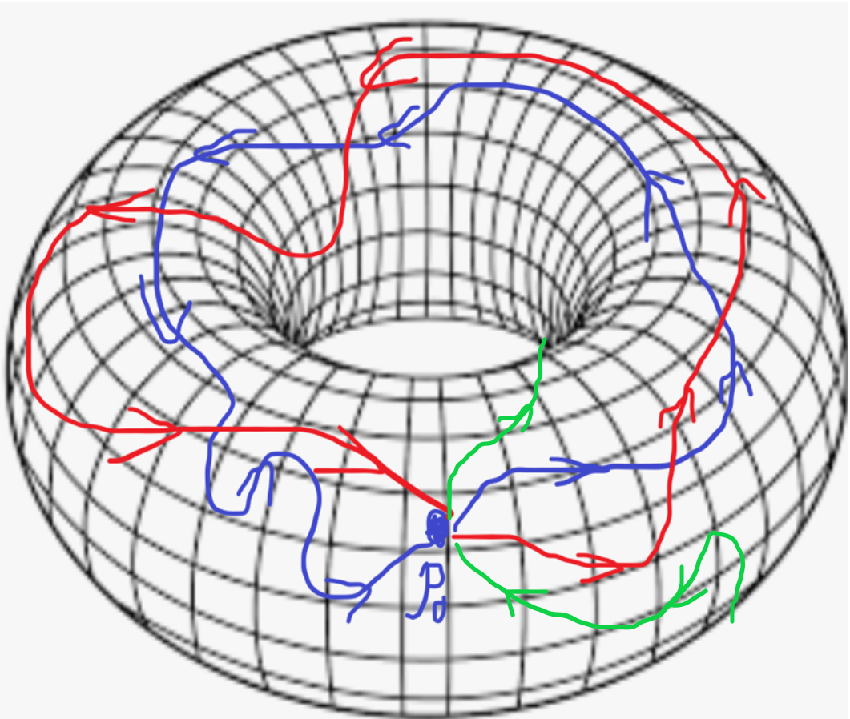
Example 4
We choose $G=π_{1}(𝕋^{2})$ to be the equivalent continuous paths that start and end at a particular point $p_{0}$ on the torus $𝕋^{2}$. By “equivalent” we mean that paths are free to be stretched on the surface of the torus as long as we don’t break them. (It is called a homotopy)

Slide 8
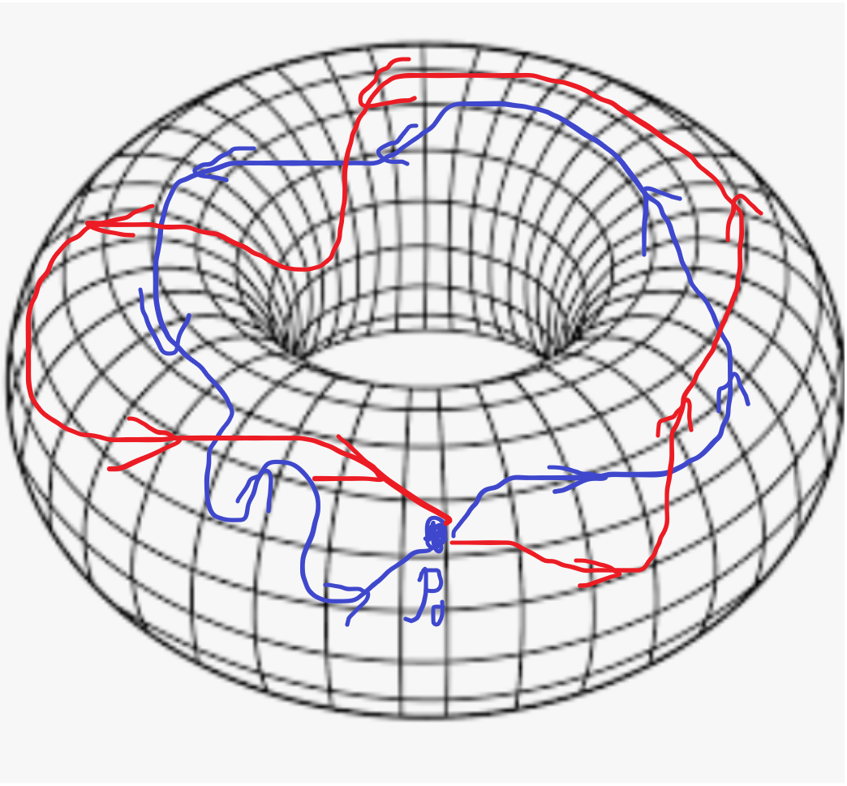
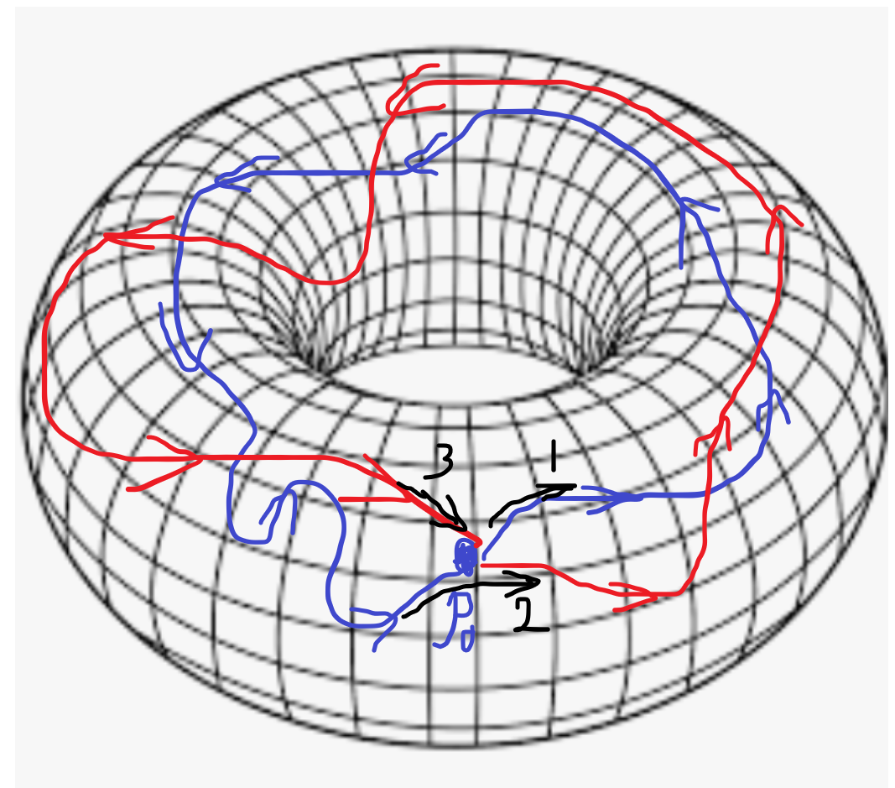
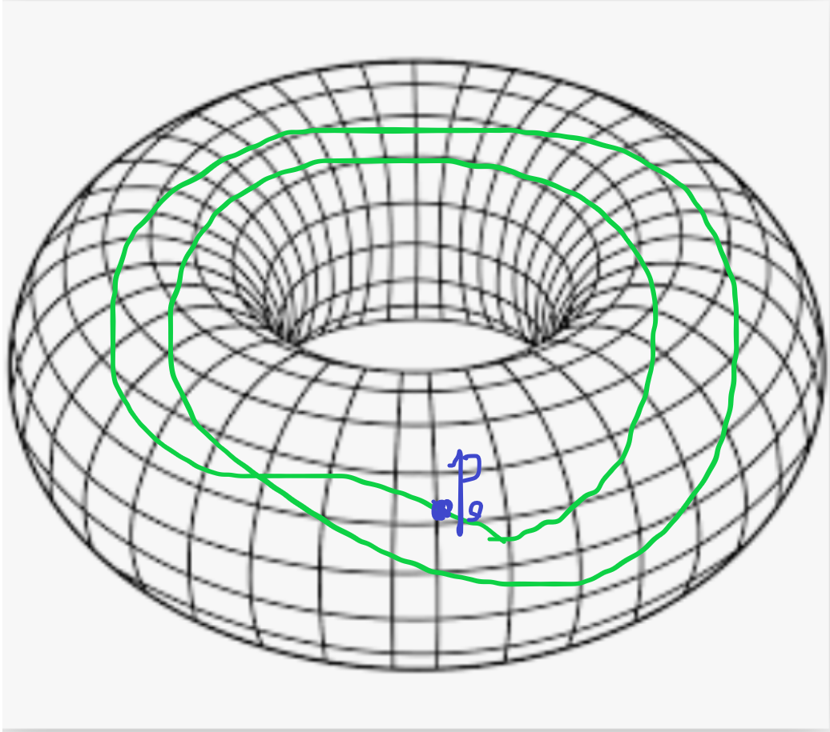
Example 4, continued
The operation on this set will be concatenation of paths. For instance, if we concatenate the blue and red paths, we will have a green path.
We can show that the four conditions hold, so this is indeed a group. We call it the fundamental group of the space $𝕋^{2},$ denoted by $π_{1}\left(𝕋^{2}\right).$ It can be shown that $π_{1}\left(𝕋^{2}\right)=ℤ×ℤ$ and is thus Abelian, but in general fundamental groups don’t need to be Abelian.

Slide 9
Example 5 (final example, and to introduce the concept of subgroup)
A subgroup is the subset $H$ of the original group $G$, closed under the same group operation inherited from $G$.
For instance, $take {G=S}_{4}$ consisting of permutations of four numbers, but now impose another constraint that neighboring numbers must still be neighbors (we will impose periodic boundary condition so that the first and last members in the string are also neighbors).
Then (132) is not allowed, because 1234 will be changed to 3124. Previously 1 has two neighbors 2 and 4, but now it doesn’t get along with its new left-hand side neighbor 3.

Slide 10
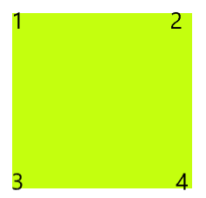
Example 5, continued
With this new restriction, we can only use part of the elements in $S_{4}$, and we will denote this available part $D_{4}$. We can show $D_{4}$ is a subgroup of $S_{4},$but it would be obvious if we interpret $D_{4}$ from another perspective.
Suppose we have a square flashcard, with four corners labeled by $1, 2, 3, 4$ respectively. Now we want to pin it to a bulletin by fixing the corners. The way we pin it corresponds exactly to our $D_{4}.$

Slide 11
Example 5, continued, again, (and possibly introduce the concept of group action)
For instance, we may rotate and then pin it.
Notice that if read the index clockwise from the left top, we are actually changing 1243 into 3124. This is equivalent to (1342)!
We may also flip it upside down
Now 1243 becomes 3421, which corresponds to (13)(24)
We can easily enumerate all possible changes. There will be 4 rotations (one of them will be the identity since we rotate 360° for nothing) and 4 mirror symmetry for us to flip (two diagonal, one horizontal and one vertical). Thus $\left|D_{4}\right|=8.$
Traditionally, we use $\{e,σ,σ^{2},σ^{3},τ,τσ,τσ^{2},τσ^{3}\}$ to represent $D_{4}$.

Slide 12
What is left behind in $S_{4}$? (an introduction to coset)
Now we know that $D_{4}$ is a subgroup of $S_{4}$, and since $\left|D_{4}\right|=8=\frac{24}{3}=\left|S_{4}\right|$, we know take one third out of $S_{4}$, what is left behind in $S_{4}$, can we say something about it?
Yes, what is left in the original group will be “grouped” into cosets.
In order to see that, let’s write out explicitly in permutation representations.
$$D_{4}=\left\{e, \left(1342\right),\left(14\right)(23),\left(1243\right),\left(12\right)\left(34\right),\left(13\right)\left(24\right), \left(23\right),(14)\right\}$$
corresponding respectively to identity, clockwise rotation by 90°/ 180°/ 270°, horizontal/ vertical/ two diagonal flips (or reflections, if you prefer this term)

Slide 13
Coset
Now if we choose an element in $S_{4}$that is not in $D_{4}$, say $(12)$, and compose it with each element in $S_{4}$, we will have
$$\left(12\right)D_{4}=\{\left(12\right), \left(134\right),\left(1423\right),\left(243\right),\left(34\right),\left(1324\right),\left(123\right),(142)\}$$
Amazingly, we see that elements in $\left(12\right)D_{4}$ are totally different from those in $D_{4}$, so we successfully “group” out 8 other elements in $S_{4}$.
If we do this again by choosing an element not in $D_{4}$ and$\left(12\right)D_{4}$, say $\left(13\right)$, after some calculation we can see that $\left(13\right)D_{4}$ gets the last 8 elements.
Thus, we have $S_{4}=D_{4}∪\left(12\right)D_{4}∪\left(13\right)D_{4}$.

Slide 14
Coset, continued (and introduce normal subgroup and simple group)
This procedure generalizes to the idea of cosets. For a subgroup $H$ of a group $G$, we can use an element $g∉H$ to general a set $gH$ that doesn’t intersect $H$ at all. We call $gH$ a left-coset (it is some elements “grouped” together, but not a group. You don’t even have an identity in $gH$).
From this, we can see immediately that for any finite group $G$, the order of its subgroup $H$ must be a factor of $\left|G\right|$ (known as Lagrange’s theorem), and the number of cosets is given by $\left|G\right|/|H|$, also termed as index, denoted by $\left[G:H\right]=$ $\left|G\right|/|H|$
Usually, $gH≠Hg$, but if that happens, $H$ will be called a normal subgroup. If a group doesn’t have any normal subgroups other than $\left\{e\right\}$ and itself, it will be called a simple group.

Slide 15
Can we say something more about $D_{4}$? (introduce conjugacy class)
We go back to Greek letters to represent $D_{4}$ as $\{e,σ,σ^{2},σ^{3},τ,τσ,τσ^{2},τσ^{3}\}$
Is there any way to classify elements within this group?
Yes, some smart guy found out that, we can classify them by conjugacy class. For any element $a∈G$, we define its conjugacy class by conjugating every element $g$ on it, namely $\{gag^{−1}:g∈G\}$
For $D_{4}$, after some cumbersome algebra we can divide it into
$$D_{4}=\left\{e\right\}∪\left\{σ^{2}\right\}∪\left\{σ,σ^{3}\right\}∪\left\{τ,τσ^{2}\right\}∪\{τσ,τσ^{3}\}$$
Notice that $σ^{2}$ itself forms a class, which means that $gσ^{2}g^{−1}$ must still be $σ^{2}$ for any $g∈D_{4}$, so $gσ^{2}=σ^{2}g$ is always true. It means that $σ^{2}$ commutes with every element in this group, and thus belongs to the center $Z\left(D_{4}\right)=\left\{e,σ^{2}\right\}$, which consists of all friendly elements that is willing to exchange positions with every other members in the group.

Slide 16
Conjugacy class, center, coset, and normal subgroup
By far we can see very intricate relations among all the concepts we have encountered. We will list some, but certainly not all, here.
1. If the conjugacy class is also a subgroup, it must be a normal subgroup.
2. It follows then the center of a group is always a normal subgroup.
3. Things will get more complicated if we go to the quotient group $G/H$ by treating each coset as a new element with the operation $\left(aH\right)\left(bH\right)=\left(ab\right)H$ or introduce centralizer or derived subgroup. We can get a whole bunch of interesting identities and homomorphisms.
Usually, it is not easy to compute any of these for a general group. Try doing the conjugacy class for $SO\left(3\right)$ and it could take your whole day. (By adjoint formula one can show that each conjugacy class of $SO\left(3\right)$ consists of rotations through the same angle regarding all possible axes). Try proving $SO(3)$ is simple could take a whole week. Thus, we need more tools to analyze groups.

Slide 17
Some interesting stuff before we move on
$D_{n}$ can similarly be regarded as shape-preserving actions on the regular $n$-polygon, with $\left|D_{n}\right|=2n$, and there is also a concise way to represent $D_{n}$ by using only two generators $\{σ,τ\}$ and three constraints $σ^{n}=τστσ=τ^{2}=e.$
Any finite group can be regarded as a permutation group, i.e., a subgroup of some symmetric group $S_{n}$. (Cayley’s theorem)
It is hard to find simple ones in finite groups. Generations of mathematicians worked out hundreds of thousands of papers before they found out every single finite simple group. This feat, now called classification of finite simple groups, was announced complete in 1983, more than one century later than when the concept of group was created by Galois.

Slide 18
What is the best way to represent a group?
For $D_{n}$, we use Greek letters $σ,τ$
For $S_{n}$, we use ordered numbers like $(12)$
For $SO(n)$, we use a pair$(n,θ)$
There is not even a common way to represent them and so no standard way of describing how the group operation will act on two elements.
What is $στ^{ }$ composed with $τσ^{6}τστ$? (This one might not be hard if you are familiar with $D_{n}$)
What is (1452) composed with (6531)?
What is $(n_{1},θ_{1})$ composed with $\left(n_{2},θ_{2}\right) in the general case where n_{1}≠n_{2}?$
It just doesn’t work out well using those representations.
Recall that we also use orthogonal matrices to represent $SO(3)$ in linear algebra. This gives us a hint, why don’t we use matrices to represent groups?

Slide 19
Matrix representation
If we can represent elements in a group by matrices, then all kinds of operations will now be matrix multiplication, an operation that is well-studied.
Formally, for a group $G$, we want to find a linear vector space $V$ and a homomorphism $U$ from the group $G$ to the linear operators on $V$ such that $U\left(g_{1}\right)U\left(g_{2}\right)=U(g_{1}g_{2})$
Especially when we have a basis for the linear space $V$, we can write down matrix representations of $U\left(g\right),$ denoted by $D\left(g\right)$. Then we have $D\left(g_{1}\right)D\left(g_{2}\right)=D(g_{1}g_{2})$, where the operation now is simply matrix multiplication.
If the representation is $1−1$, we will call it faithful, otherwise degenerate. The dimension of the linear space (and thus the matrix) will be called the dimension of the representation.

Slide 20
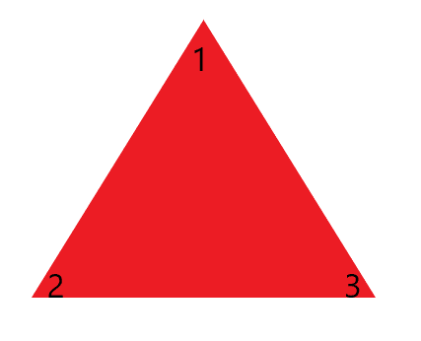
Example of matrix representation
Here is one matrix representation of $D_{3}=S_{3}$
$e=\left(\begin{matrix}1 & 0 \\ 0 & 1\end{matrix}\right), \left(23\right)=$ $\left(\begin{matrix}1 & 0 \\ 0 & −1\end{matrix}\right), \left(13\right)=\frac{1}{2}\left(\begin{matrix}1 & \sqrt{3} \\ −\sqrt{3} & −1\end{matrix}\right),$
$$\left(12\right)=\frac{1}{2}\left(\begin{matrix}1 & \sqrt{3} \\ \sqrt{3} & 1\end{matrix}\right), \left(123\right)=\frac{1}{2}\left(\begin{matrix}−1 & \sqrt{3} \\ −\sqrt{3} & −1\end{matrix}\right), \left(132\right)=\frac{1}{2}\left(\begin{matrix}−1 & −\sqrt{3} \\ \sqrt{3} & −1\end{matrix}\right)$$
You may already notice that these matrices are reflections and rotations on the 2-d plane. Yes, that’s exactly how it is obtained.
The representation above is faithful. We can have another degenerate representation that $e=1, \left(123\right)=1, \left(132\right)=1, \left(12\right)=−1, \left(23\right)=−1,\left(13\right)=−1.$ We can see rotations are mapped to 1 since they are orientation-preserving, while flips/ reflections are mapped to -1 sine they are not.
We can even have a more degenerate (which renders it more boring) representation that sends every element to 1.

Slide 21
The matrix representation is not unique
It is obvious that the matrix representation cannot be unique, as can be seen from three perspectives:
1. Ware free to choose the vector space $V$.
2. Even for the same $V$, we may have different way to set up the homomorphism $U$.
3. Even for the same $V$ and $U$, we can use different basis vectors in $V$ so that the matrix representation $D$ will show up differently.
But from perspective 3, we also find an epiphany, since we know that matrix representation of the same linear operator, despite looking different with different bases, must similar, meaning that $D_{ }^{2}\left(g\right)=TD^{1}\left(g\right)T^{−1}$ where $T$ is an invertible change of basis. This gives us a motivation to define which representations are the “same”.

Slide 22
Equivalent representations
We generalize the idea to define the equivalency of two representations ${(V}_{1},U_{1})$ and $\left(V_{2},U_{2}\right)$
If there is a homomorphism (sometimes also called an intertwining operator) $φ:V_{1}→V_{2}$ such that $U_{2}\left(g\right)φ\left(v\right)=φ\left(U_{1}\left(g\right)v\right)$ for every $v∈V_{1}$
If $φ$ is an isomorphism, meaning that it is invertible, we will have $\left(φ^{−1}U_{2}\left(g\right)φ\right)\left(v\right)=U_{1}\left(g\right)\left(v\right).$This resembles much the similarity of two matrices, so we will call the two representations equivalent if such an isomorphism could be found.
From now on we will use superscript to indicate different representations.

Slide 23
Smaller, easier
For a matrix representation $D^{μ}\left(g\right)$, we all know that smaller matrices are easier to handle. Thus, we are asking whether we can decompose a representation into “smaller” ones.
If we can decompose the vector space $V$ into $V_{1}⊕V_{2}$ such that each subspace can form its own representation of $G$, then we say that this representation $V$ is decomposable. If not, it is indecomposable.
Or perhaps we can find a subspace $W$ of $V$, such that $W$ is invariant under every linear operation induced by $g.$ In this case we say this representation is reducible. Otherwise, irreducible.
It is clear from definition that an irreducible representation must be indecomposable, but the inverse is in general not true.

Slide 24
Symmetric, easier
Sometimes reducibility also comes with symmetry, which makes things easier (and more in common).
For instance, the Wigner-Eckart theorem
proves that by resorting to spherical tensors $T_{q}^{k}$, which forms an irreducible space for each $k$ under the operation of $SO\left(3\right)/SU(2)$, we gain something universal (the C-G coefficients).

Slide 25
Counterexample
Consider $G=\left(ℝ,+\right)$ which can be represented by
$$r→\left(\begin{matrix}1 & r \\ 0 & 1\end{matrix}\right)$$
This is a faithful and indecomposable representation. The faithfulness is obvious. In order to see why it is indecomposable, we prove by contradiction.
Suppose it is decomposable, then since the representation has dimension 2, the only way to decompose it is into two 1-d subspacs spanned by two linear independent vectors $v, w.$
Then $v$and $w$ must be eigenvectors of $\left(\begin{matrix}1 & r \\ 0 & 1\end{matrix}\right)$, but the only eigenvalue of this matrix is $λ=1$, with only one eigenvector $\left(1, 0\right).$
But this representation is not irreducible because the subspace $\left(1,0\right)$ is invariant.

Slide 26
The Grand Orthogonality Theorem
If we adopt the following symbols
$n_{G}:$ order of the group $G$
$ν,μ:$ inequivalent, irreducible representations
$D^{μ}(g)$: the $μ$matrix representation of $g∈G$ with respect to an orthonormal basis
We will have Schur’s great theorem
$$\frac{n_{μ}}{n_{G}}\sum_{g}^{ }{D_{μ}^{\text{†}}}{\left(g\right)}_{i}^{k}D^{μ}{\left(g\right)}_{i}^{j}=δ_{μ}^{ν}δ_{i}^{j}δ_{l}^{k}$$
$$\sum_{μ,l,k}^{ }{\frac{n_{μ}}{n_{G}}D^{μ}{\left(g\right)}_{ k}^{l}D_{μ}^{\text{†}}}{\left(g′\right)}_{ l}^{k}=δ_{gg′}^{ }$$

Slide 27
Let’s go back to nonlinear dynamics
In order to apply group theory to nonlinear dynamics, we consider the action of a group $G$ on a space. Our aforementioned matrix representation can also be regarded as an action of $G,$ via $U,$ on the linear space $V.$
For instance, if we have an autonomous system $\dot{x}=Ax$, we can think of time evolution $f^{t}$ as an action on the state space $ℳ$. All $f^{t}$ form a semigroup $G$ (condition 1, 2, 3 still holds, but the inverse may not exist)
If we choose a start point $x_{0}∈$ $ℳ$, we can get its trajectory by applying every $f^{t}∈G$ to $x_{0}$.
Generalizing this idea, if the group $G$ can act on a set $S.$ we define the orbit of an element $s∈S$ by $\left\{g(s)\right|g∈G\}$

Slide 28
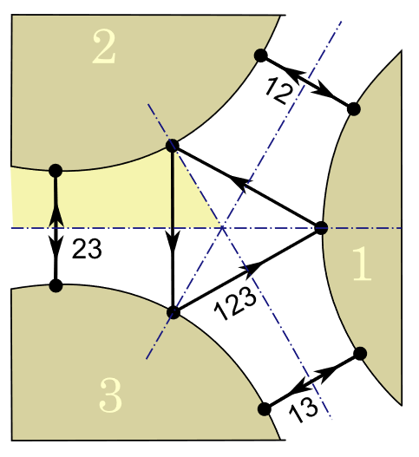
Symmetric system
For systems with symmetries, we can even act group elements on a trajectory to form orbits of orbits.
Picture copied from dem Buch.

Slide 29
Reduced state space, fundamental domain, and others
We can continue to apply those notions in nonlinear dynamics. For instance, if we make all points in the state space $ℳ$ equivalent if they are on the same $G$-orbit, we have the reduced state space$ℳ/G$
If our $G$ above is discreet, we have a special case called fundamental domain.
If points in$ℳ$ are invariant under group actions, i.e. $gx=x$ for every $g∈G$, they are called invariant points.
If it is a region, then we have invariant subspace.
For invariant subspace, we can also check its reducibility.
…

