Slide 1
Charting the state space
Temporal Ordering
Spatial Ordering
Kneading Theory

Slide 2
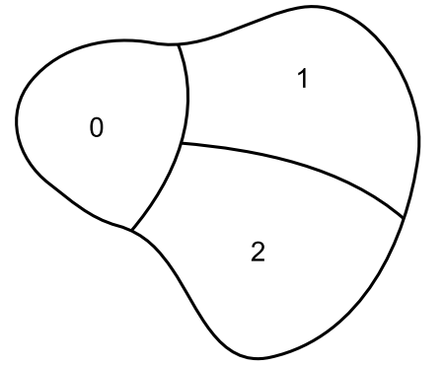
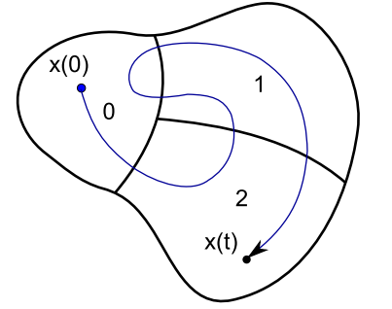
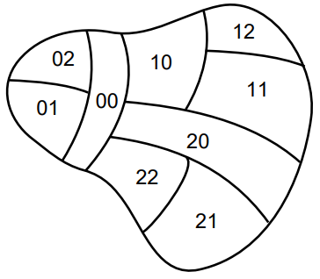
Review: symbolic dynamics
Discretizing the state space
Simpler description of complicated dynamics
Describe trajectories as state transitions

Slide 3
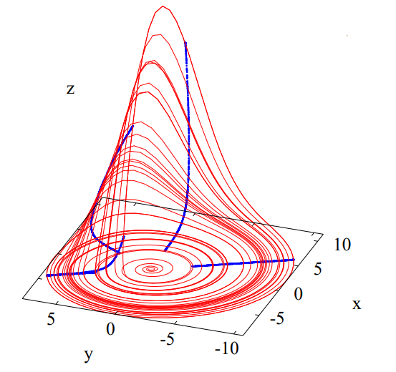
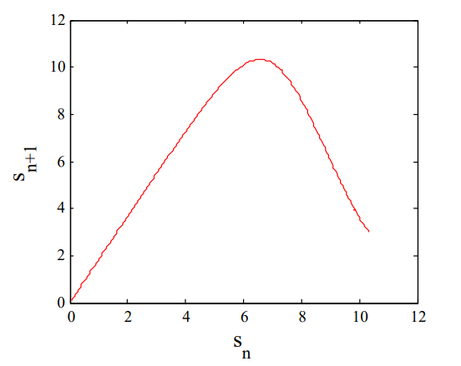
Application to 1-d maps
Why?
We can reduce annoying higher-dimensional systems to 1-D Poincare maps
1-D maps are easy!
Let’s focus on those

Slide 4
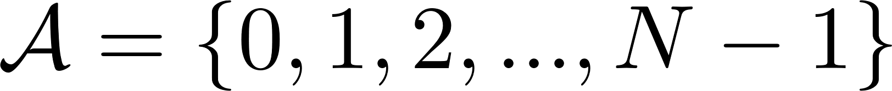
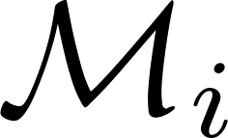

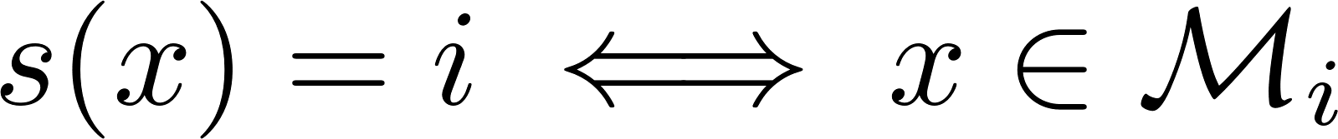
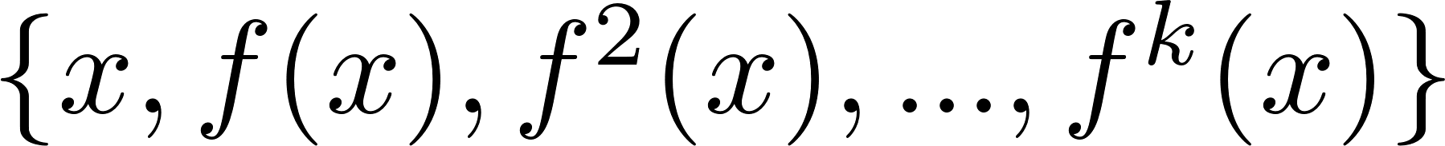


Concept review
Alphabet
Itinerary
set of points in partition $i$
set of all possible sequences in alphabet
Orbit
characterized by initial condition $x$
Symbolic code

Slide 5
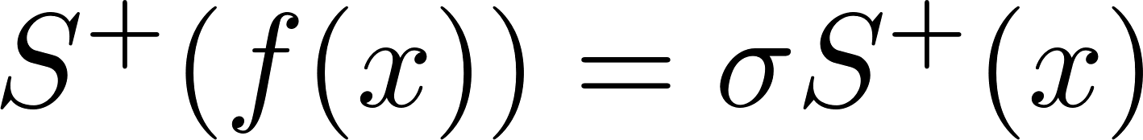
Concept review
Itinerary of time-one map
So, applying $f$ to a point $x$ is equivalent to applying a shift operator $σ$ on its itinerary
Periodic orbits
& periodic points

Slide 6
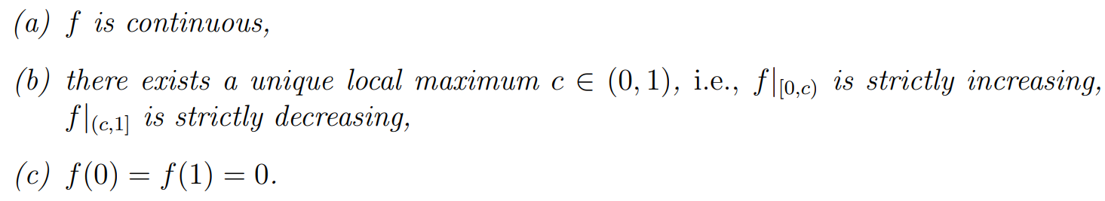
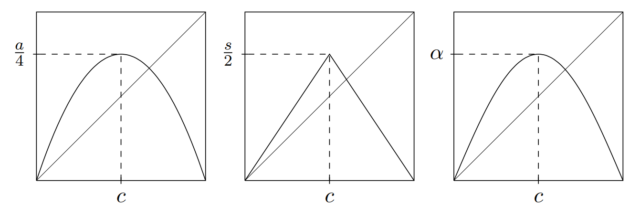
unimodal maps
By assumption, the critical value is a maximum and has its own symbol C

Slide 7
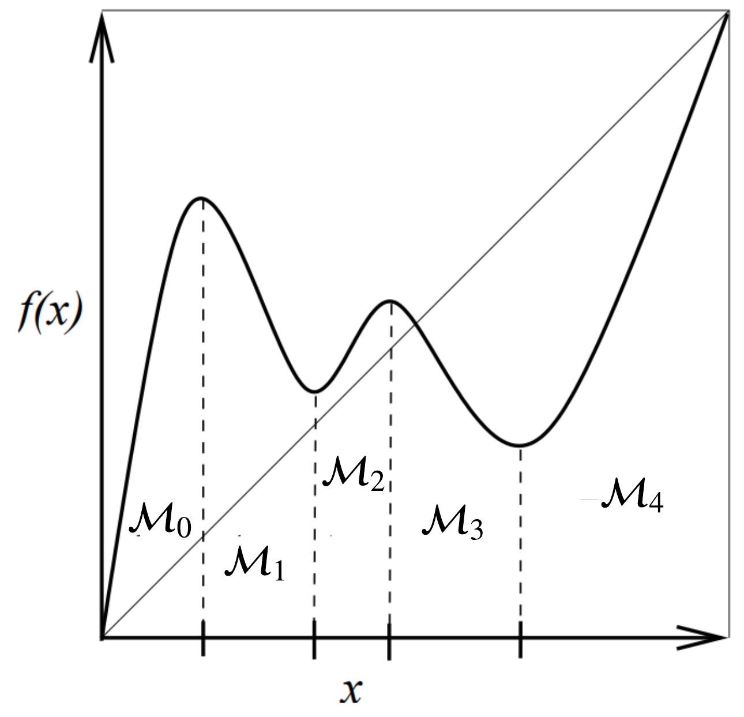
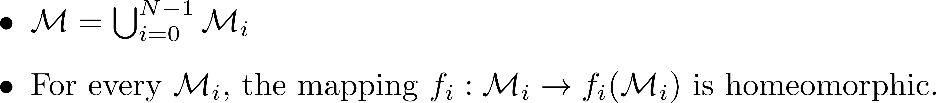
Partitioning 1-dimensional maps
Generally, we want to find disjoint partitions such that
Critical points are nice!

Slide 8
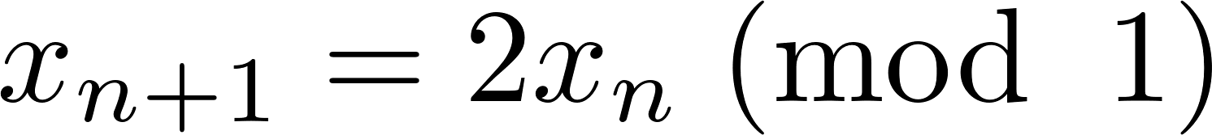
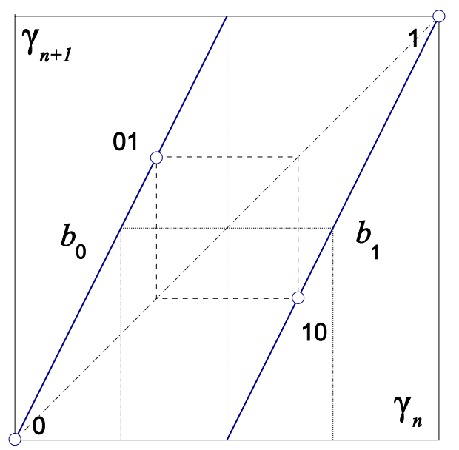
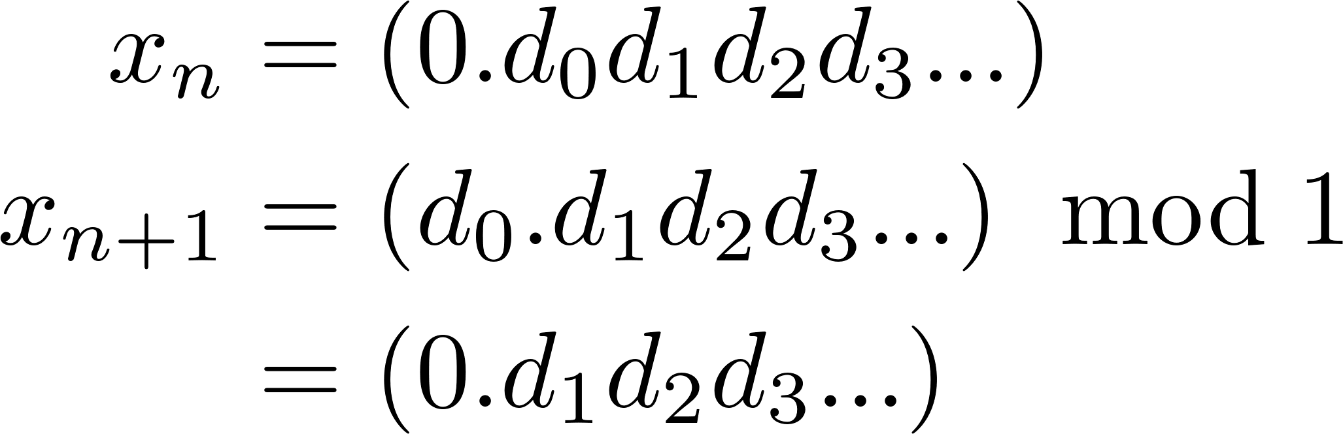
The Bernoulli map
The natural partitions are
Both are disjoint and satisfy homeomorphic constraints, i.e.
In binary representation, the map just performs a shift and a drop.

Slide 9
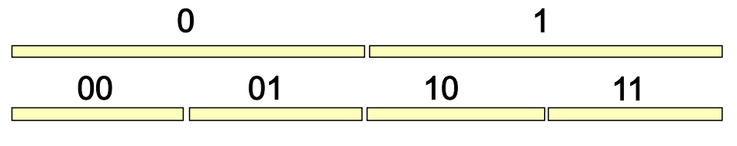
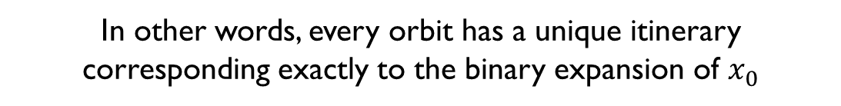
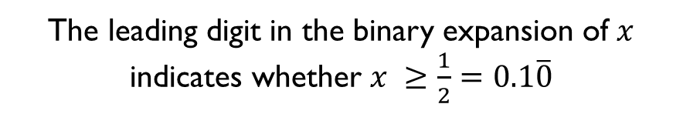
The Bernoulli map
The leading digit in the binary expansion of $x$ indicates whether $x ≥\frac{1}{2}=0.1\overline{0}$
Since the map only stretched, it preserves orientation in both branches. This leads to preservation of spatial ordering.
In other words, every orbit has a unique itinerary corresponding exactly to the binary expansion of $x_{0}$

Slide 10
Temporal ordering vs. spatial ordering
Temporal Ordering
Given a point $x_{0}∈ ℳ$, what is the itinerary of its orbit?
Just iterate the map and assign symbolic codes to values based on which partition they lie in
Spatial Ordering
Given an itinerary, what is the associated $x_{0}?$
A bit harder! So why do we care?

Slide 11

Why do we care?
Symbolic representations can help us identify which orbits appear and disappear as a parameter is varied
Bifurcations
Also, if we want to study a dynamical system using its symbolic dynamics. They better be equivalent ☺
i.e., there is a bijection
$$x_{1}≠x_{2} ↔S^{+}\left(x_{1}\right)≠S^{+}(x_{2})$$

Slide 12
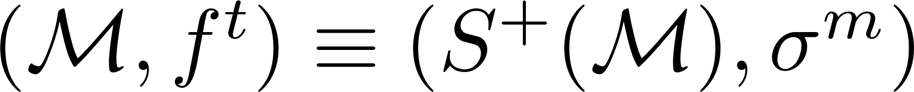
Why do we care? (part ii)
$$x_{1}≠x_{2} ↔S^{+}\left(x_{1}\right)≠S^{+}(x_{2})$$
This bijection implies that the symbolic sequence for a point uniquely identifies it, i.e.
Essentially a change of coordinate
Partitions that satisfy this bijection are called generating.

Slide 13
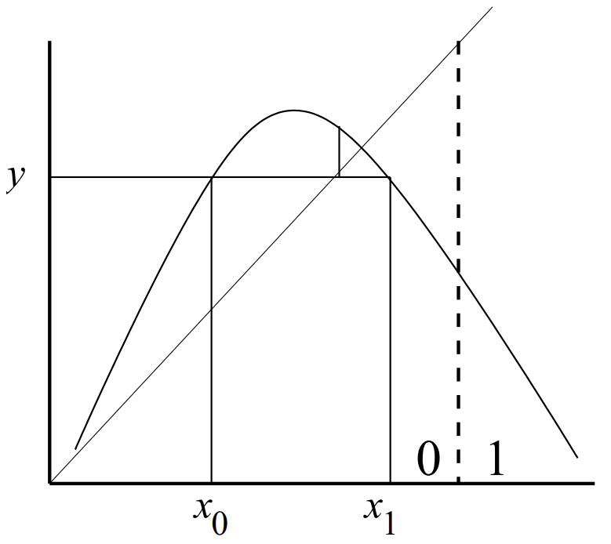

Counter Example
$x_{0}≠x_{1}$ but $S^{+}\left(x_{0}\right)=S^{+}(x_{1})$
Probably isn’t very useful!

Slide 14
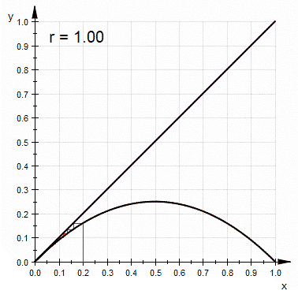
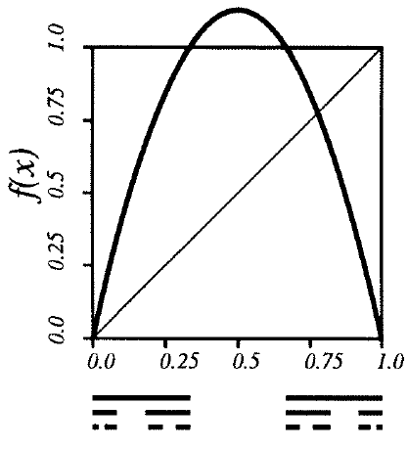
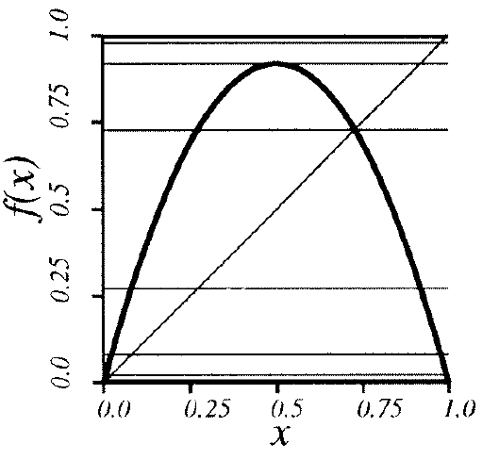
Example: the logistic map
Because the critical value is a maximum
We need a rule! A criterion!
https://en.wikipedia.org/wiki/Logistic_map

Slide 15
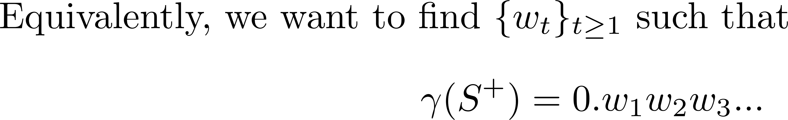
More formally!

Slide 16
Why do we care? (part iii)
Now we can describe topologically similar (but metrically different) systems using the same “canonical” symbolic dynamics.

Slide 17
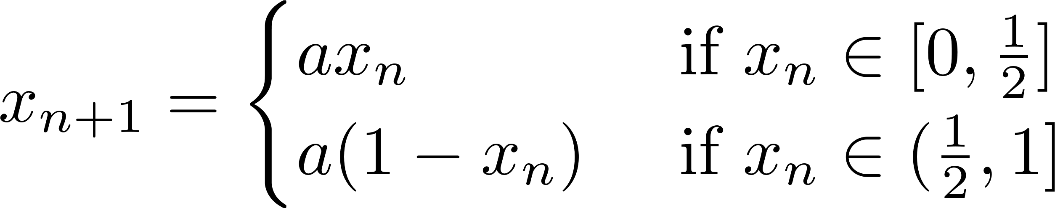
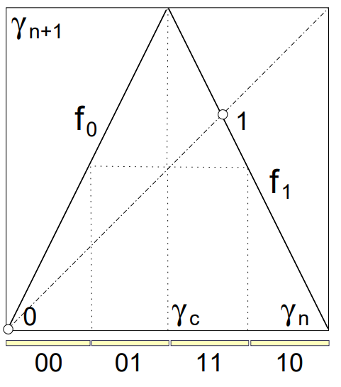
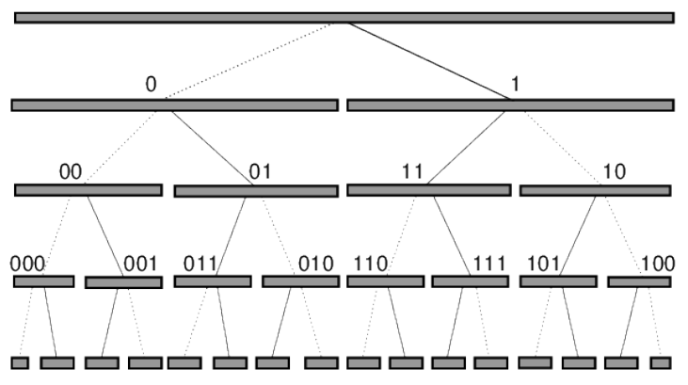
Example: The tent map

Slide 18
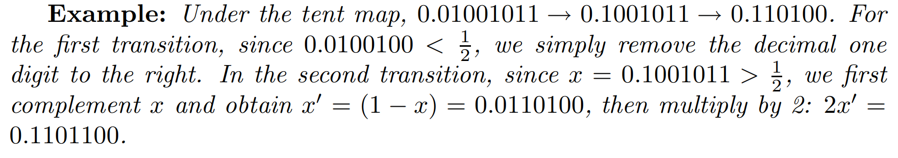
Understanding the tent’s action

Slide 19
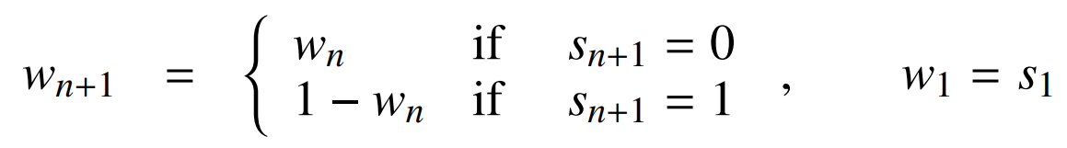

Getting $γ$ From the tent

Slide 20


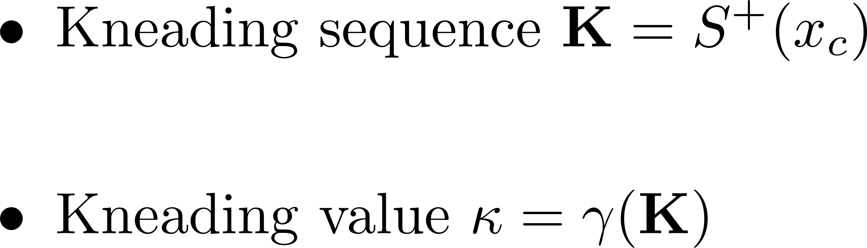
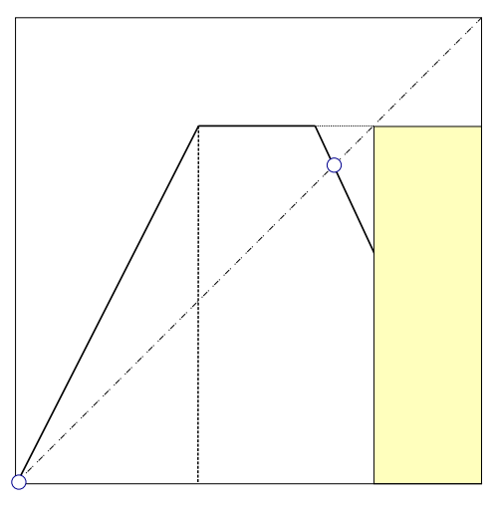

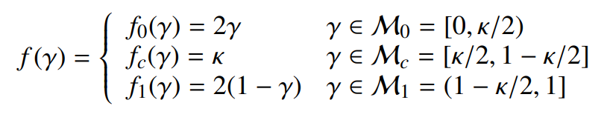
Kneading theory: grammar of chaos the road to topological conjugacy

Slide 21
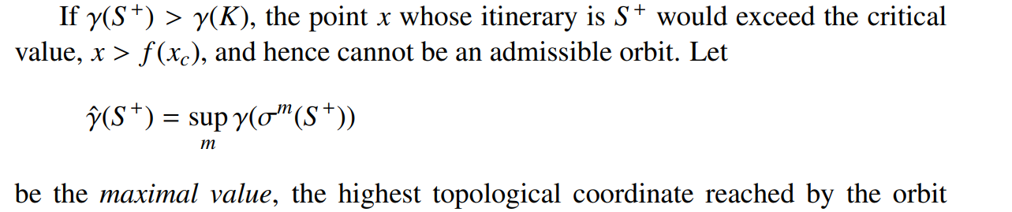
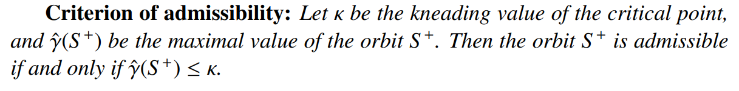
Criterion of admissibility

Slide 22

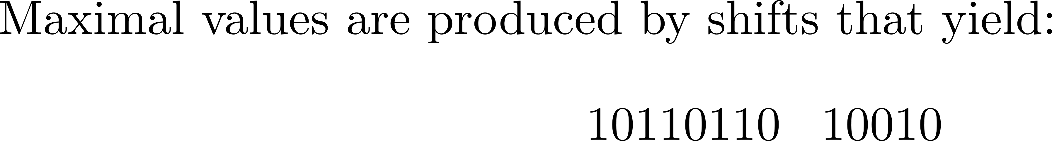
Example

